Slide 1
Accelerometers and Magnetometers
Design Team 3

Slide 2
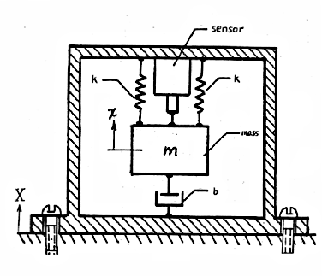
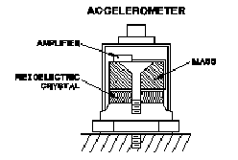
Accelerometers - History - Types
Accelerometers behave as a damped mass on a spring. Acceleration causes displacement of this "spring" proportional to the acceleration experienced.
Original Invention
  1923 - Burton McCollum and
Peter Orville
  Commercialized in 1927
Piezoelectric
  1943 - Used Rochelle salt
Piezoresistive
  1959 - Warren P. Mason
Original Accelerometer Patent
Piezo-based Accelertometers
Accelerometer Background
Accelerometer Fundamentals
Magnetometer Background
Magnetometer Fundamentals
Conclusion and Questions
Introduction

Slide 3
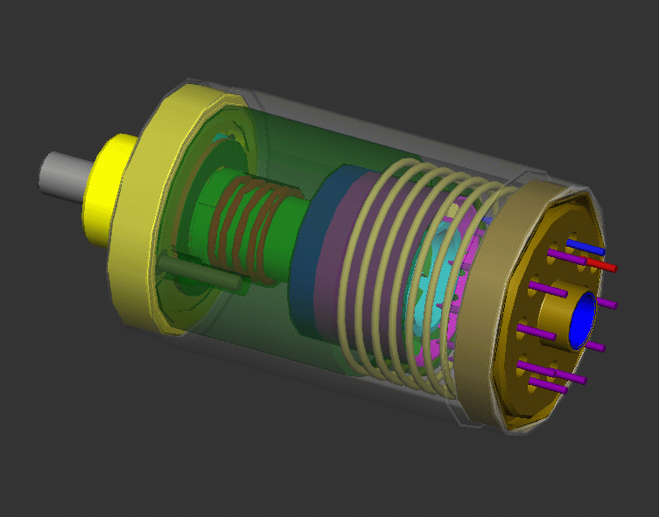
Accelerometers - History - Types
Hall Effect
  1961 - Heinz E. Kallmann
Magnetoresistive
  1973 - Tetsuji Shimizu
Capacitive
  1989 - Hitachi, Ltd.
Digital Capacitive
  1994 - William C. Tang/Ford Motors
Hall Effect Accelerometer
Accelerometer Background
Accelerometer Fundamentals
Magnetometer Background
Magnetometer Fundamentals
Conclusion and Questions
Introduction

Slide 4
Accelerometer - Applications
Video games
Hard drive protection
Electronic Stability Package
Vehicle crash detection
Earthquake sensors
Accelerometer Background
Accelerometer Fundamentals
Magnetometer Background
Magnetometer Fundamentals
Conclusion and Questions
Introduction

Slide 5

Accelerometer - Fundamentals
Acceleration: . At sea level we experience 32.2 ft/s² = 9.81 m/s² = 1g
Examples of g-forces:
This room = your weight = 1g
Space Shuttle reentry & launch = 3g Top Thrill Dragster roller-coaster = 4.5g
Max for fighter jet pilots = 11g to 12g Max experienced by a human* = 46.2g
Death or extensive & severe injuries= +50g
Modern accelerometers are small microelectromechanical systems (MEMS) consisting of a cantilever beam with a proof mass. Thus they sense acceleration in only one direction.
* John Stapp on December 10th, 1954 in the rocket sled "Sonic Wind" going over 632 MPH and stopping over a water break.
Accelerometer Background
Accelerometer Fundamentals
Magnetometer Background
Magnetometer Fundamentals
Conclusion and Questions
Introduction

Slide 6
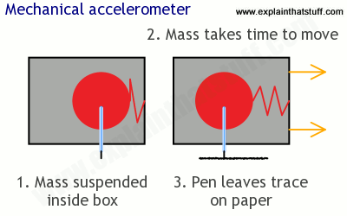
Accelerometer - Fundamentals
There are many different types of accelerometers.
Mechanical acts like customers sitting in a car.
They have something like a mass attached to a spring suspended inside an outer casing.
When they accelerate, the casing moves off immediately but the mass lags behind and the spring stretches with a force that corresponds to the acceleration.
The distance the spring stretches (which is proportional to the stretching force) can be used to measure the force and the acceleration in a variety of different ways.
Seismometers (used to measure earthquakes): using pens on heavy masses attached to springs to register earthquake forces.
Earthquake shakes the seismometer cabinet but the pen (attached to a mass) takes longer to move, so it leaves a jerky trace on a paper chart.
Accelerometer Background
Accelerometer Fundamentals
Magnetometer Background
Magnetometer Fundamentals
Conclusion and Questions
Introduction

Slide 7
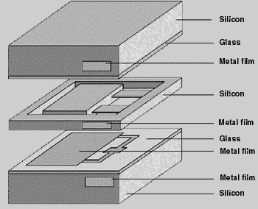
Capacitive Accelerometer
Cantilever made of silicon, holding two plates suspended between energized reference rails. Our knowledge of the elasticity of silica is the basis of acceleration sensing.
Structure is symmetric, reducing temperature effects and providing more precise measurement. As the reference "mass" approaches one reference plate, the air-gap to the other reference plate increases.
The device operates with a DC input voltage. V_{OUT-DC} will change linearly to acceleration variations. V_{out} = V_{g0} + V_{sens.}*G ; V_{Sensitivity}=(V_{out,+1g} - V_{out-1g})/(2g)
This design is cheap and usually accurate to +/- 0.01g, have a shock tolerance up to 200 Km/s² and sensitive to at least 1.5V/g with a V_{CC} of 5.0V.
Accelerometer Background
Accelerometer Fundamentals
Magnetometer Background
Magnetometer Fundamentals
Conclusion and Questions
Introduction

Slide 8
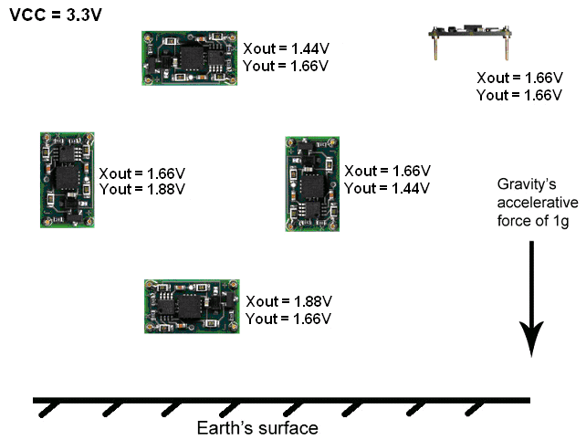
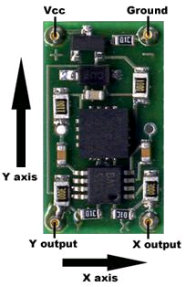
Accelerometer - Examples
DE-ACCM6G Buffered ±6g Accelerometer
Dimension Engineering
Has ±6g sense range
222 mV/g sensitivity
Accelerometer Background
Accelerometer Fundamentals
Magnetometer Background
Magnetometer Fundamentals
Conclusion and Questions
Introduction

Slide 9
Accelerometer - Examples
Acceleration to voltage example:
”What voltage will correspond to an acceleration of -0.5g?”
The 0g point is approximately 1.66V. Sensitivity is 222mV/g
V_{out} = V_{g0} + V_{sens.}*G.
-0.5g * 0.222mV/g = -0.111V
1.66V – 0.111V = 1.55V
Therefore you can expect a voltage of approximately 1.55V when experiencing an acceleration of -0.5g.
Accelerometer Background
Accelerometer Fundamentals
Magnetometer Background
Magnetometer Fundamentals
Conclusion and Questions
Introduction

Slide 10
Accelerometer - Examples
Tilt to voltage example:
“I am making an antitheft device that will sound an alarm if it is tilted more than 10º with respect to ground in any direction. I have measured the 0g bias point to be 1.663V, and I want to know what voltage to trigger the alarm at.”
Sin(10º) = 0.1736 so acceleration with a tilt of 10º will be 0.1736g
0.1736g * 0.222V/g = 0.0385V
1.663 + 0.0385 = 1.7015V
1.663 – 0.0385 = 1.6245V
Sound the alarm when the voltage reaches more than 1.7015V or less than 1.6245V.
Accelerometer Background
Accelerometer Fundamentals
Magnetometer Background
Magnetometer Fundamentals
Conclusion and Questions
Introduction

Slide 11
Magnetometers - Background
Compass invented by the Chinese in the 4th century
Carl Gauss invents the "magnometer" in 1833
Two types of magnetometers
  Scalar - measures the total strength of the magnetic field they are subject to
  Vector - measure the component of the magnetic field in a particular direction, relative to the spatial orientation of the device
Accelerometer Background
Accelerometer Fundamentals
Magnetometer Background
Magnetometer Fundamentals
Conclusion and Questions
Introduction

Slide 12
Magnetometers - Background
Magnetometers are used to measure the strength of the magnetic field and in some cases direction of the field.
A sensor which is attached to this device measures the flux density of the surrounded magnetic field around it.
Magnetic flux density is proportional to the magnetic field strength => output directly gives the intensity or strength of the magnetic lines.
Earth is surrounded by the lines of flux which vibrate at the different frequencies depending on the locations.
Any object or anomaly which distorts this magnetic field is detected by magnetometer.
Accelerometer Background
Accelerometer Fundamentals
Magnetometer Background
Magnetometer Fundamentals
Conclusion and Questions
Introduction

Slide 13
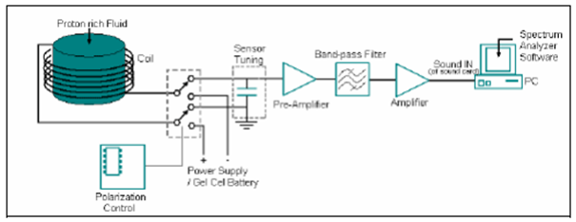
Magnetometers - SCALAR
[Proton Precession Magnetometer]
  It uses the nuclear magnetic resonance (NMR) to measure the resonance frequency of the protons in a magnetic field.
    A polarizing DC current is passed through a solenoid, that creates high magnetic flux around the hydrogen -rich fuel like kerosene.
    Some of these protons are aligned with this flux.
    When the polarizing flux is released, the frequency of precession of the protons to normal realignment can be used to measure the magnetic field.
Accelerometer Background
Accelerometer Fundamentals
Magnetometer Background
Magnetometer Fundamentals
Conclusion and Questions
Introduction
Notes:
Precession: the slow movement of the axis of a spinning body around another axis due to a torque (such as gravitational influence) acting to change the direction of the first axis. It is seen in the circle slowly traced out by the pole of a spinning gyroscope.

Slide 14
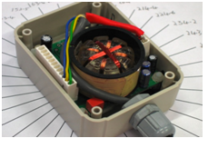
Magnetometers - Vector
[Fluxgate Magnetometer]
These are used for the high sensitive applications.
A fluxgate sensor drive has an alternating drive current that runs a permeable core material.
It consists of magnetically susceptible core wound by two coils of wire.
One coil is excited by the AC supply and constantly changing field induces an electrical current in the second coil.
This current change is based on the background field.
Hence the alternating magnetic field, and the induced output current, will be out of step with the input current.
The extent to which this is the case will depend on the strength of the background magnetic field.
Accelerometer Background
Accelerometer Fundamentals
Magnetometer Background
Magnetometer Fundamentals
Conclusion and Questions
Introduction

Slide 15

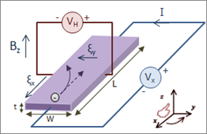
Magnetometers - Principles of Operation
Hall Effect Magnetometer
Lorentz Force -
Benefits-
Solid-state
Low Temperature
Sensitivity
Highly Linear
Small
Cheap
Drawbacks-
Saturation limit
Calibration Issues
Accelerometer Background
Accelerometer Fundamentals
Magnetometer Background
Magnetometer Fundamentals
Conclusion and Questions
Introduction

Slide 16
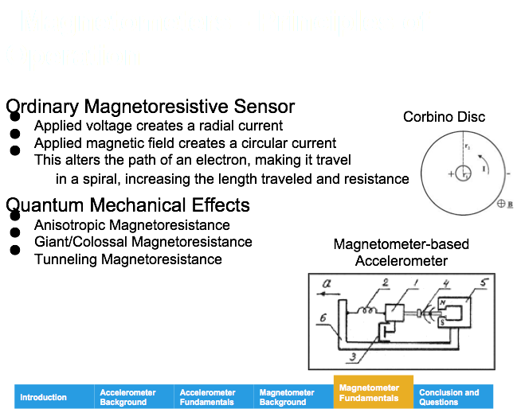

Slide 17
Magnetometer - Applications
Navigation: Navigation: space explorations,
Compass : geographical and archeological surveys, space explorations,
Mineral exploration :- In oil and gas industry for directional drilling process.
Security: Metal detector
Soil Science: To detect the mineralization
Hard drives
Accelerometer Background
Accelerometer Fundamentals
Magnetometer Background
Magnetometer Fundamentals
Conclusion and Questions
Introduction
Notes:
Navigation
Compass
Mineral exploration - Oil- insects consume hydrocarbons and create magnetite
Military applications - submarines
Archaeology- can find buried stones, rocks, bricks, basalt and granite.
Security- Airport metal detectors

Slide 18
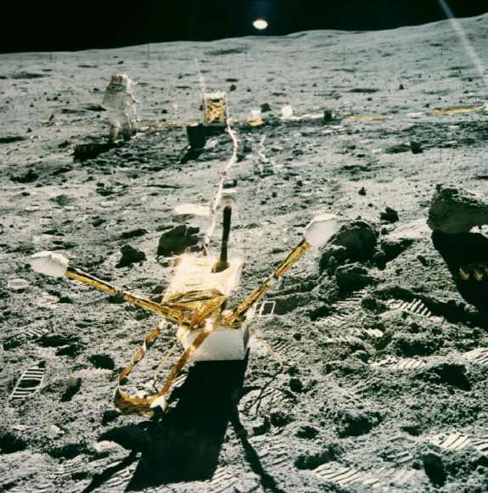
Magnetometer - Applications
Geology and planetary science
Accelerometer Background
Accelerometer Fundamentals
Magnetometer Background
Magnetometer Fundamentals
Conclusion and Questions
Introduction

Slide 19

Magnetometer - Applications
Military applications
Accelerometer Background
Accelerometer Fundamentals
Magnetometer Background
Magnetometer Fundamentals
Conclusion and Questions
Introduction

Slide 20
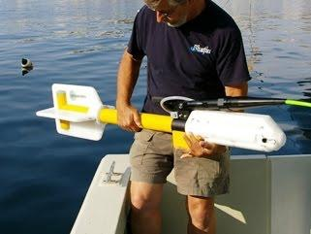
Magnetometer - Applications
Archaeology and rescue missions
Accelerometer Background
Accelerometer Fundamentals
Magnetometer Background
Magnetometer Fundamentals
Conclusion and Questions
Introduction

Slide 21

Questions
Accelerometer Background
Accelerometer Fundamentals
Magnetometer Background
Magnetometer Fundamentals
Conclusion and Questions
Introduction

